Slide 1

Software Testing and Quality Assurance Unit 1 Software Quality Assurance Fundamentals
By :Mrs. Priya Pawar

Slide 2
Points To BE COVERED
Definition of Quality, Quality Assurance, Quality Control
Difference between QA and QC, Software Quality Assurance Challenges
Software Quality Assurance, SQA Planning & Standards (ISO 9000, Six Sigma)
SQA Activities

Slide 3
Points To BE COVERED
Building Blocks of SQA
Software Quality factors
Software Quality Metrics: Process Metrics & Product Metrics
Software Reliability & Reliability Measurement Factors: ROCOF, MTTF, MTTR, MTBF, POFOD, Availability

Slide 4
Software Testing and Quality Assurance
Quality Management – Ensuring that required level of product quality is achieved
Defining procedures and standards
Applying procedures and standards to the product and process
Checking that procedures are followed
Collecting and analyzing various quality data Definition of Quality, Quality Assurance, Quality Control

Slide 5
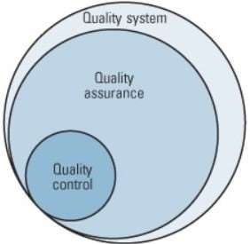
Definition of Quality, Quality Assurance, Quality Control
Software quality is defined as a field of study and practice that describes the desirable attributes of software products.
Quality assurance and Quality control are two aspects of quality management.
While some quality assurance and quality control activities are interrelated, the two are defined differently.

Slide 6
Definition of Quality Assurance, Quality Control
Quality Assurance : Quality assurance can be defined as "part of quality management focused on providing confidence that quality requirements will be fulfilled." The confidence provided by quality assurance is twofold—internally to management and externally to customers, government agencies, regulators, certifiers, and third parties.
Quality Control :Quality control can be defined as "part of quality management focused on fulfilling quality requirements." While quality assurance relates to how a process is performed or how a product is made, quality control is more the inspection aspect of quality management. An alternate definition is "the operational techniques and activities used to fulfill requirements for quality."

Slide 7
Difference between Quality Assurance, Quality Control
QA is a preventive process, while QC is a corrective measure.
Quality assurance is process-oriented; however, Quality control is product oriented.
QA is focused on taking actions to create a good quality product, and QC is focused on resulting in a quality assured product.
Quality Control (QC) It is a procedure that focuses on providing assurance that quality requested will be achieved. It is a procedure that focuses on fulfilling the quality requested.
QA aims to prevent the defect. QC aims to identify and fix defects

Slide 8
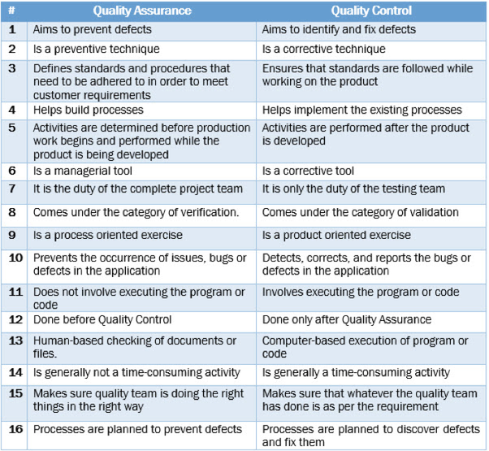
Difference between Quality Assurance, Quality Control

Slide 9
Software quality assurance (SQA)
Software quality assurance (SQA) is a process that assures that all software engineering processes, methods, activities, and work items are monitored and comply with the defined standards. These defined standards could be one or a combination of any like
ISO 9000, CMMI model, ISO15504, etc.
The SQA plan document consists of the below sections:
Purpose section
Reference section
Software configuration management section
Problem reporting and corrective action section
Tools, technologies, and methodologies section
Code control section
Records: Collection, maintenance, and retention section
Testing methodology

Slide 10
SQA Elements
SQA includes all 4 elements :
Software Quality Assurance – Establishment of network of
organizational procedures and standards leading to
high-quality software
Software Quality Planning – Selection of appropriate
procedures and standards from this framework and adaptation
of these to specific software project
Software Quality Control – Definition and enactment of
processes that ensure that project quality procedures and
standards are being followed by the software development
team
Software Quality Metrics – Collecting and analyzing quality
data to predict and control quality of the software product
being developed

Slide 11
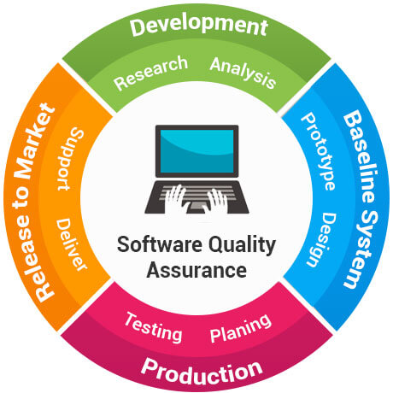
Software Quality Assurance Plan
Abbreviated as SQAP, the software quality assurance plan comprises the procedures, techniques, and tools that are employed to make sure that a product or service aligns with the requirements defined in the SRS(software requirement specification).

Slide 12
SQA Planning & Standards (ISO 9000, Six Sigma)
Software quality assurance (SQA) is a process that assures that all software engineering processes, methods, activities, and work items are monitored and comply with the defined standards. These defined standards could be one or a combination of any like ISO 9000, CMMI model, ISO15504, etc.
SQA incorporates all software development processes starting from defining requirements to coding until release. Its prime goal is to ensure quality
1) Creating an SQA Management Plan:
The foremost activity includes laying down a proper plan regarding how the SQA will be carried out in your project.
Along with what SQA approach you are going to follow, what engineering activities will be carried out, and it also includes ensuring that you have the right talent mix in your team.

Slide 13
SQA Activities
2) Setting the Checkpoints:
The SQA team sets up different checkpoints according to which it evaluates the quality of the project activities at each checkpoint/project stage. This ensures regular quality inspection and working as per the schedule.
3) Apply software Engineering Techniques:
Applying some software engineering techniques aids a software designer in achieving high-quality specifications. For gathering information, a designer may use techniques such as interviews and FAST (Functional Analysis System Technique).
Later, based on the information gathered, the software designer can prepare the project estimation using techniques like WBS (work breakdown structure), SLOC (source line of codes), and FP(functional point) estimation.

Slide 14
SQA Activities
4) Executing Formal Technical Reviews:
An FTR is done to evaluate the quality and design of the prototype.
In this process, a meeting is conducted with the technical staff to discuss the actual quality requirements of the software and the design quality of the prototype. This activity helps in detecting errors in the early phase of SDLC and reduces rework effort in the later phases.
5) Having a Multi-Testing Strategy:
By multi-testing strategy, we mean that one should not rely on any single testing approach, instead, multiple types of testing should be performed so that the software product can be tested well from all angles to ensure better quality.
6) Enforcing Process Adherence:
This activity insists on the need for process adherence during the software development process. The development process should also stick to the defined procedures.

Slide 15
SQA Activities
7) Controlling Change:
In this activity, we use a mix of manual procedures and automated tools to have a mechanism for change control.
By validating the change requests, evaluating the nature of change, and controlling the change effect, it is ensured that the software quality is maintained during the development and maintenance phases.
8) Measure Change Impact:
If any defect is reported by the QA team, then the concerned team fixes the defect.
After this, the QA team should determine the impact of the change which is brought by this defect fix. They need to test not only if the change has fixed the defect, but also if the change is compatible with the whole project.

Slide 16
SQA Activities
8) For this purpose, we use software quality metrics that allow managers and developers to observe the activities and proposed changes from the beginning till the end of SDLC and initiate corrective action wherever required.
9) Performing SQA Audits:
The SQA audit inspects the entire actual SDLC process followed by comparing it against the established process.
It also checks whether whatever was reported by the team in the status reports was actually performed or not. This activity also exposes any non-compliance issues.
10) Maintaining Records and Reports:
It is crucial to keep the necessary documentation related to SQA and share the required SQA information with the stakeholders. The test results, audit results, review reports, change requests documentation, etc. should be kept for future reference.
11) Manage Good Relations:
In fact, it is very important to maintain harmony between the QA and the development team.
We often hear that testers and developers often feel superior to each other. This should be avoided as it can affect the overall project quality.

Slide 17
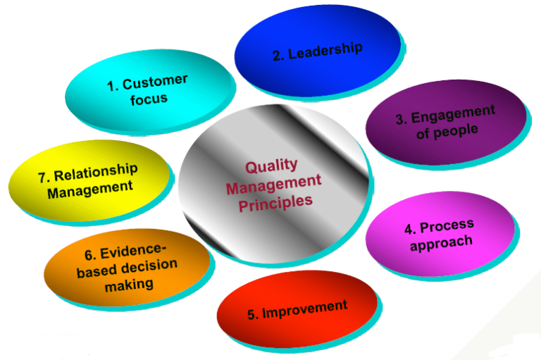
SQA Planning & Standards (ISO 9000, Six Sigma)
ISO 9000: This standard is based on seven quality management principles which help the organizations to ensure that their products or services are aligned with the customer needs.
7 principles of ISO 9000 are depicted in the below image:

Slide 18
SQA Planning & Standards (ISO 9000, Six Sigma)
This activity is a blend of two sub-activities which are explained below in detail:
(i) Product Evaluation:
This activity confirms that the software product is meeting the requirements that were discovered in the project management plan. It ensures that the set standards for the project are followed correctly.
(ii) Process Monitoring:
This activity verifies if the correct steps were taken during software development. This is done by matching the actually taken steps against the documented steps.

Slide 19
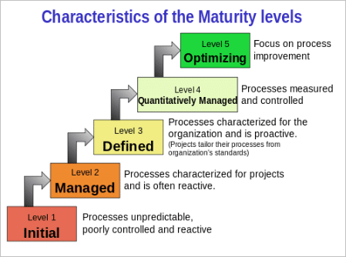
SQA Planning & Standards (ISO 9000, Six Sigma)
CMMI level: CMMI stands for Capability maturity model Integration. This model originated in software engineering. It can be employed to direct process improvement throughout a project, department, or entire organization.
5 CMMI levels and their characteristics are described in the below image:
An organization is appraised and awarded a maturity level rating (1-5) based on the type of appraisal.

Slide 20
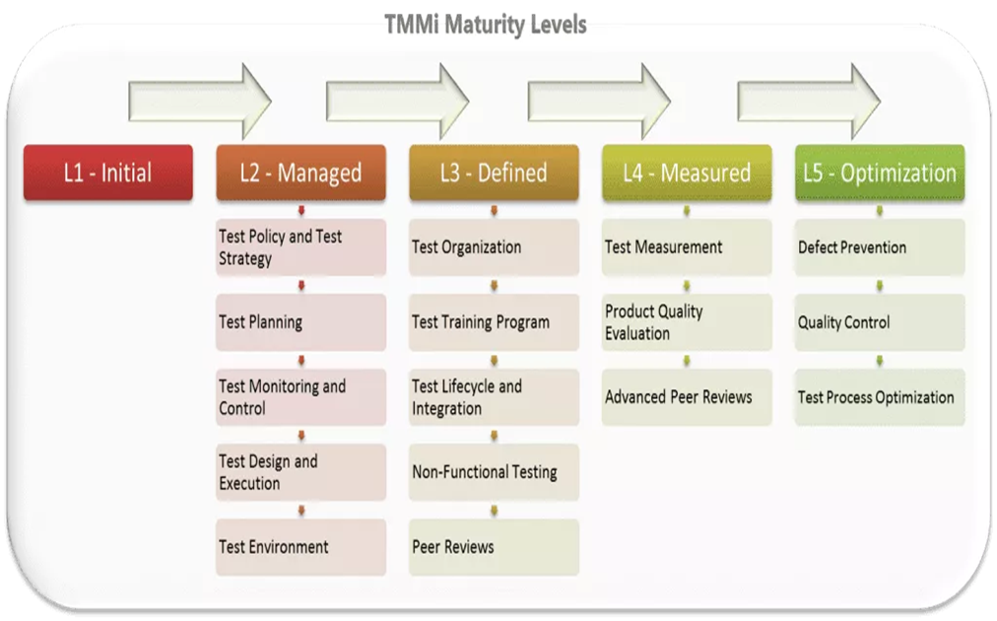
5 TMMi levels :
An organization is appraised and awarded a maturity level rating (1-5) based on the type of appraisal.
Test Maturity Model integration (TMMi): Based on CMMi, this model focuses on maturity levels in software quality management and testing.

Slide 21
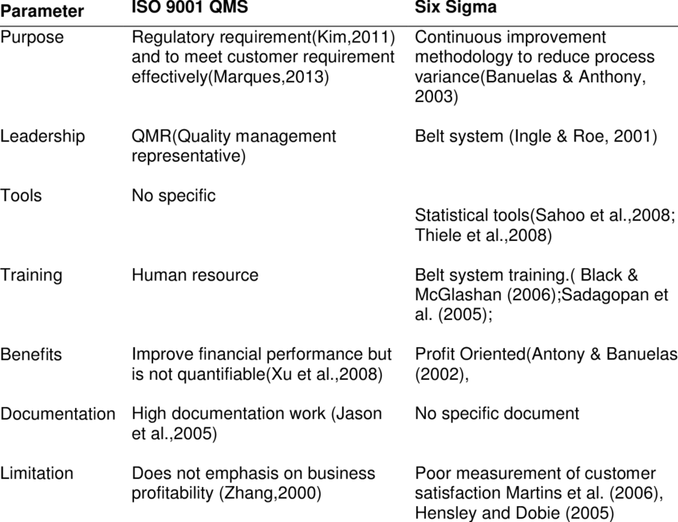
Diffrence Between iso and six sigma

Slide 22
six sigma
Six Sigma not only helped large organizations but can be used for smaller firms to save on loss on capital and effectively manage time-schedules. The first quality assurance benefit from Six Sigma is the quality approach that no methodology has been able to replicate in terms of the results compared to what Six Sigma has been able to provide over the years.
Six sigma’s quality assurance methodology has set the benchmark for excellence by raising the standards in a way that can implement quality assurance management.
The quality assurance system works well in every sector that requires QA services,
• Quality assurance in Healthcare
• Quality assurance in Retail
• Quality assurance in BPO
• Quality assurance in Manufacturing
• Quality assurance in education
• Quality assurance in pharmacy

Slide 23
Software Quality Assurance (SQA) activities:
Software Quality Assurance is composed of a variety of tasks associated with two different fields:
(i) The software engineers who do technical work.
(ii) SQA group that has responsibility for quality assurance planning, oversight, record keeping, analysis, and reporting.
Basically, software engineers address quality (and perform quality assurance and quality control activities) by applying solid technical methods and measures, conducting formal technical reviews, and performing well-planned software testing.

Slide 24
SQA Plan for a Project :
This type of plan is developed during project planning and is reviewed by all interested parties. The quality assurance activities performed by the software engineering team and the SQA group are governed by the plan.
The plan identifies: evaluations to be performed audits and reviews to be performed
standards that are applicable to the project
procedures for error reporting and tracking
all the documents to be produced by the SQA group
the total amount of feedback provided to the software project team

Slide 25
Software quality metrics :
Software quality metrics are a subset of software metrics that focus on the quality aspects of the product, process, and project. These are more closely associated with process and product metrics than with project metrics.
Software quality metrics can be further divided into three categories −
Product quality metrics
In-process quality metrics
Maintenance quality metrics
Product Quality Metrics
This metrics include the following −
Mean Time to Failure
Defect Density
Customer Problems
Customer Satisfaction

Slide 26
Quality Assurance vs. Strategic Approach
Quality Assurance
Emphasis on finding and correcting defects before reaching market
Strategic Approach
Proactive, focusing on preventing mistakes from occurring
Greater emphasis on customer satisfaction

Slide 27
Determinants of Quality
Ease of
use
Design
Conforms to design
Service

Slide 28
Top management
Design
Procurement
Production/operations
Quality assurance
Packaging and shipping
Marketing and sales
Customer service
Failure Costs - costs incurred by defective parts/products or faulty services.
Internal Failure Costs :Costs incurred to fix problems that are detected before the product/service is delivered to the customer.
External Failure Costs :All costs incurred to fix problems that are detected after the product/service is delivered to the customer.

Slide 29

ISO 9000 Standards
ISO 9000 Standards
Requirements
System requirements
Management
Resource
Realization
Remedial
ISO 9000 Quality Management Principles
Customer focus
Leadership
People involvement
Process approach
A systems approach to management
Continual improvement
Factual approach to decision making

Slide 30
Total Quality Management
A philosophy that involves everyone in an organization in a continual effort to improve quality and achieve customer satisfaction.
T
Q
M

Slide 31
The TQM Approach
Find out what the customer wants
Design a product or service that meets or exceeds customer wants
Design processes that facilitates doing the job right the first time
Keep track of results
Extend these concepts to suppliers

Slide 32
Elements of TQM
Continual improvement
Competitive benchmarking
Employee empowerment
Team approach
Decisions based on facts
Knowledge of tools
Supplier quality
Champion
Quality at the source
Suppliers

Slide 33
Quality at the Source
The philosophy of making each worker responsible for the quality of his or her work.

Slide 34
Six Sigma
Statistically
Having no more than 3.4 defects per million
Conceptually
Program designed to reduce defects
Requires the use of certain tools and techniques
Six sigma: A business process for improving quality, reducing costs, and increasing customer satisfaction.

Slide 35
Six Sigma Programs
Six Sigma programs
Improve quality
Save time
Cut costs
Employed in
Design
Production
Service
Inventory management
Delivery

Slide 36
Six Sigma Management
Providing strong leadership
Defining performance metrics
Selecting projects likely to succeed
Selecting and training appropriate people
Improving process performance
Reducing variation
Utilizing statistical models
Designing a structured improvement strategy

Slide 37
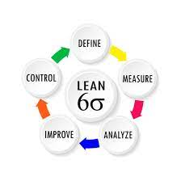
Six Sigma Process
Define
Measure
Analyze
Improve
Control
DMAIC

Slide 38
The PDSA Cycle
Plan
Act
Do
Study

Slide 39
The Process Improvement Cycle
Figure. 9.3
Select a
process
Document
Study/document
Evaluate
Seek ways to
Improve it
Implement the
Improved process
Design an
Improved process

Slide 40
Other Basic Quality Tools
Flowcharts
Check sheets
Histograms
Pareto Charts
Scatter diagrams
Control charts
Cause-and-effect diagrams
Run charts

Slide 41
Building Blocks of SQA
Software Quality Assurance (SQA) is a set of activities for ensuring quality in software engineering processes. It ensures that developed software meets and complies with the defined or standardized quality specifications. SQA is an ongoing process within the Software Development Life Cycle (SDLC) that routinely checks the developed software to ensure it meets the desired quality measures.

Slide 42
Components of SQA System
An SQA system always combines a wide range of SQA components. These components can be classified into the following six classes −
Pre-project components
This assures that the project commitments have been clearly defined considering the resources required, the schedule and budget; and the development and quality plans have been correctly determined.
Components of project life cycle activities assessment
The project life cycle is composed of two stages: the development life cycle stage and the operation–maintenance stage.
The development life cycle stage components detect design and programming errors. Its components are divided into the following sub-classes: Reviews, Expert opinions, and Software testing.
The SQA components used during the operation–maintenance phase include specialized maintenance components as well as development life cycle components, which are applied mainly for functionality to improve the maintenance tasks.
Components of infrastructure error prevention and improvement
The main objective of these components, which is applied throughout the entire organization, is to eliminate or at least reduce the rate of errors, based on the organization’s accumulated SQA experience.

Slide 43
Components of software quality management
This class of components deal with several goals, such as the control of development and maintenance activities, and the introduction of early managerial support actions that mainly prevent or minimize schedule and budget failures and their outcomes.
Components of standardization, certification, and SQA system assessment
These components implement international professional and managerial standards within the organization. The main objectives of this class are utilization of international professional knowledge, improvement of coordination of the organizational quality systems with other organizations, and assessment of the achievements of quality systems according to a common scale. The various standards may be classified into two main groups: quality management standards and project process standards.
Organizing for SQA – the human components
The SQA organizational base includes managers, testing personnel, the SQA unit and the persons interested in software quality such as SQA trustees, SQA committee members, and SQA forum members. Their main objectives are to initiate and support the implementation of SQA components, detect deviations from SQA procedures and methodology, and suggest improvements.

Slide 44
Pre-project Software Quality Components
These components help to improve the preliminary steps taken before starting a project. It includes
Contract Review
Development and Quality Plans

Slide 45
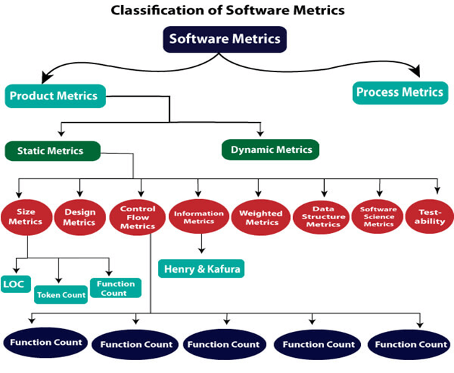
Software quality metrics
Product quality metrics
In-process quality metrics
Maintenance quality metrics
Product Quality Metrics
This metrics include the
following −
Mean Time to Failure
Defect Density
Customer Problems
Customer Satisfaction

Slide 46
Mean Time to Failure :It is the time between failures. This metric is mostly used with safety critical systems such as the airline traffic control systems, avionics, and weapons.
Defect Density: It measures the defects relative to the software size expressed as lines of code or function point, etc. i.e., it measures code quality per unit. This metric is used in many commercial software systems.
Customer Problems: It measures the problems that customers encounter when using the product. It contains the customer’s perspective towards the problem space of the software, which includes the non-defect oriented problems together with the defect problems.

Slide 47
Customer Satisfaction
Customer satisfaction is often measured by customer survey data through the five-point scale −
Very satisfied
Satisfied
Neutral
Dissatisfied
Very dissatisfied
Satisfaction with the overall quality of the product and its specific dimensions is usually obtained through various methods of customer surveys. Based on the five-point-scale data, several metrics with slight variations can be constructed and used, depending on the purpose of analysis. For example −
Percent of completely satisfied customers
Percent of satisfied customers
Percent of dis-satisfied customers
Percent of non-satisfied customers

Slide 48
In-process Quality Metrics
In-process quality metrics deals with the tracking of defect arrival during formal machine testing for some organizations. This metric includes −
Defect density during machine testing
Defect arrival pattern during machine testing
Phase-based defect removal pattern
Defect removal effectiveness

Slide 49
Maintenance Quality Metrics
Although much cannot be done to alter the quality of the product during this phase, following are the fixes that can be carried out to eliminate the defects as soon as possible with excellent fix quality.
Fix backlog and backlog management index
Fix response time and fix responsiveness
Percent delinquent fixes
Fix quality

Slide 50
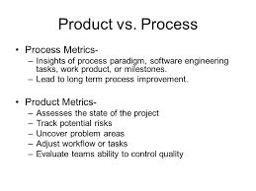
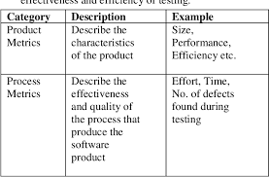
Comparison metrics Product and Process

Slide 51
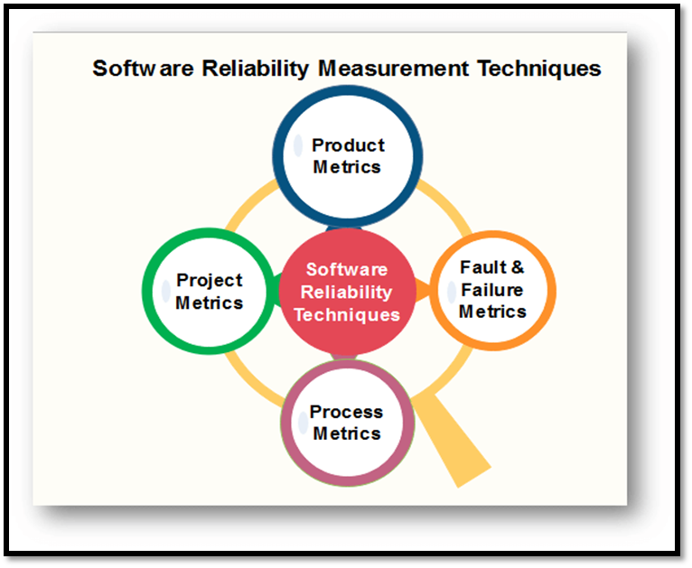
Software Reliability & Reliability Measurement Factors:
Software Reliability : Software Reliability means Operational reliability. It is described as the ability of a system or component to perform its required functions under static conditions for a specific period.
Reliability metrics are used to quantitatively expressed the reliability of the software product. The option of which parameter is to be used depends upon the type of system to which it applies & the requirements of the application domain.
Software Reliability is the probability of failure-free software operation for a specified period of time in a specified environment.
ROCOF
MTTF
MTTR
MTBF
POFOD
Availability

Slide 52
Reliability Measurement Factors:
Rate of occurrence of failure (ROCOF) :It basically measures how many times the software product fails. ROCOF measure of a software product can be obtained by having the record of the behavior of a software product. ROCOF is basically the total number of failures occurring during the specified time interval.
Mean Time To Failure (MTTF) : The average time between two successive failures is known as MTTF. It is obtained by observing a large number of failures in the software product. To measure MTTF, failure data for n failures is recorded. If the failures occur at the time instants T1, T2, …, Tn then MTTF can be calculated as:
MTTF = ( (T2 - T1) + (T3 - T2) + ... + (Tn+1 - Tn) ) / (n-1)

Slide 53
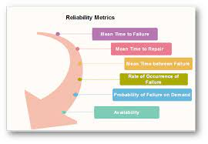
Reliability Measurement Factors:
Mean Time To Repair (MTTR) : When the software fails, it requires sometime to fix the error. MTTR is the measure of the average time system takes to find the errors that cause the failure and to fix them.
Mean Time Between Failure (MTBR) : MTBR attribute can be obtained by combining the MTTF and MTTR attributes.
MTBF = MTTF + MTTR

Slide 54
Reliability Measurement Factors:
Probability of Failure on Demand (POFOD) : This attribute does not involve time measurements like the other attributes. POFOD measures the behavior of the system failing when a service request is made.
For example, if POFOD measures 0.001 then it means that out of every 1000 one time the service requests would result in a failure.

Slide 55
Reliability Measurement Factors:
Availability : Availability of a system is a measure of possibility of availability of the system for use over a given period of time. It considers the number of failures occurring during a time interval.
It also takes into measure the down time of a system when a failure occurs. This attribute is important for systems which are supposed to be never down. This plays a vital role in telecommunication systems and operating systems. These systems need to run even during the repair time.

Slide 56


